Slide 1
Chatbot using Python
Arti DHAWALE
HRUTUJA DIWANE
Siddhi Dhamale

Slide 2
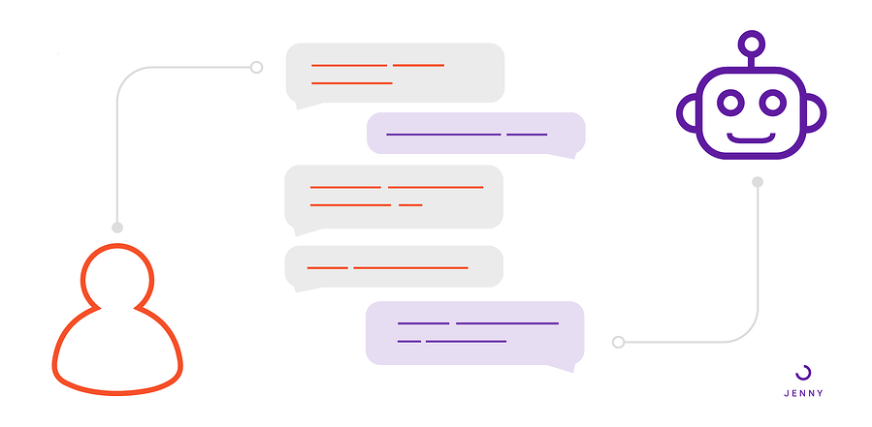
What is Chatbot?
A chatbot is an intelligent piece of software that is capable of communicating and performing actions similar to a human.
Chatbots are used a lot in customer interaction, marketing on social network sites and instantly messaging the client.
There are two basic types of chatbot models based on how they are built; Retrieval based and Generative based models.

Slide 3
Types of Chatbot
1. Retrieval based Chatbots
A retrieval-based chatbot uses predefined input patterns and responses. It then uses some type of heuristic approach to select the appropriate response. It is widely used in the industry to make goal-oriented chatbots where we can customize the tone and flow of the chatbot to drive our customers with the best experience.
2. Generative based Chatbots
Generative models are not based on some predefined responses.
They are based on seq 2 seq neural networks. It is the same idea as machine translation. In machine translation, we translate the source code from one language to another language but here, we are going to transform input into an output. It needs a large amount of data and it is based on Deep Neural networks.

Slide 4
About the Python Project – Chatbot
In this Python project with source code, we are going to build a chatbot using deep learning techniques. The chatbot will be trained on the dataset which contains categories (intents), pattern and responses. We use a special recurrent neural network (LSTM) to classify which category the user’s message belongs to and then we will give a random response from the list of responses.
Let’s create a retrieval based chatbot using NLTK, Keras, Python, etc.

Slide 5
Algorithm
Here are the 5 steps to create a chatbot in Python from scratch:
Import and load the data file
Preprocess data
Create training and testing data
Build the model
Predict the response

Slide 6
Uses of Chatbot
Chatbot is supposed to conduct a conversation with a human using textual or auditory methods.
Chatbots are used in the fields of Customer Service, Marketing and Sales.
Chatbots give companies the ability to provide 24/7 instant services to customers in a human-like manner.
Such a fast and smooth customer service help companies build brand loyalty and bring new clients to the business with lower advertising costs.
Chatbots help companies increase customer satisfaction score and provide a superior service.

